Slide 1
Web Based Virtual Reality
Using A-Frame

Slide 2
Virtual Reality?
Virtual reality (VR) is a computer-generated 3D environment simulation. A person can interact within an artificial 3D environment using special devices, such as headsets(these are special goggles with a screen) or gloves fitted with sensors.
Once we put on the these devices over our eyes, we can immerse in the virtual environment that has been created using the computer program/software. That is really super cool!

Slide 3
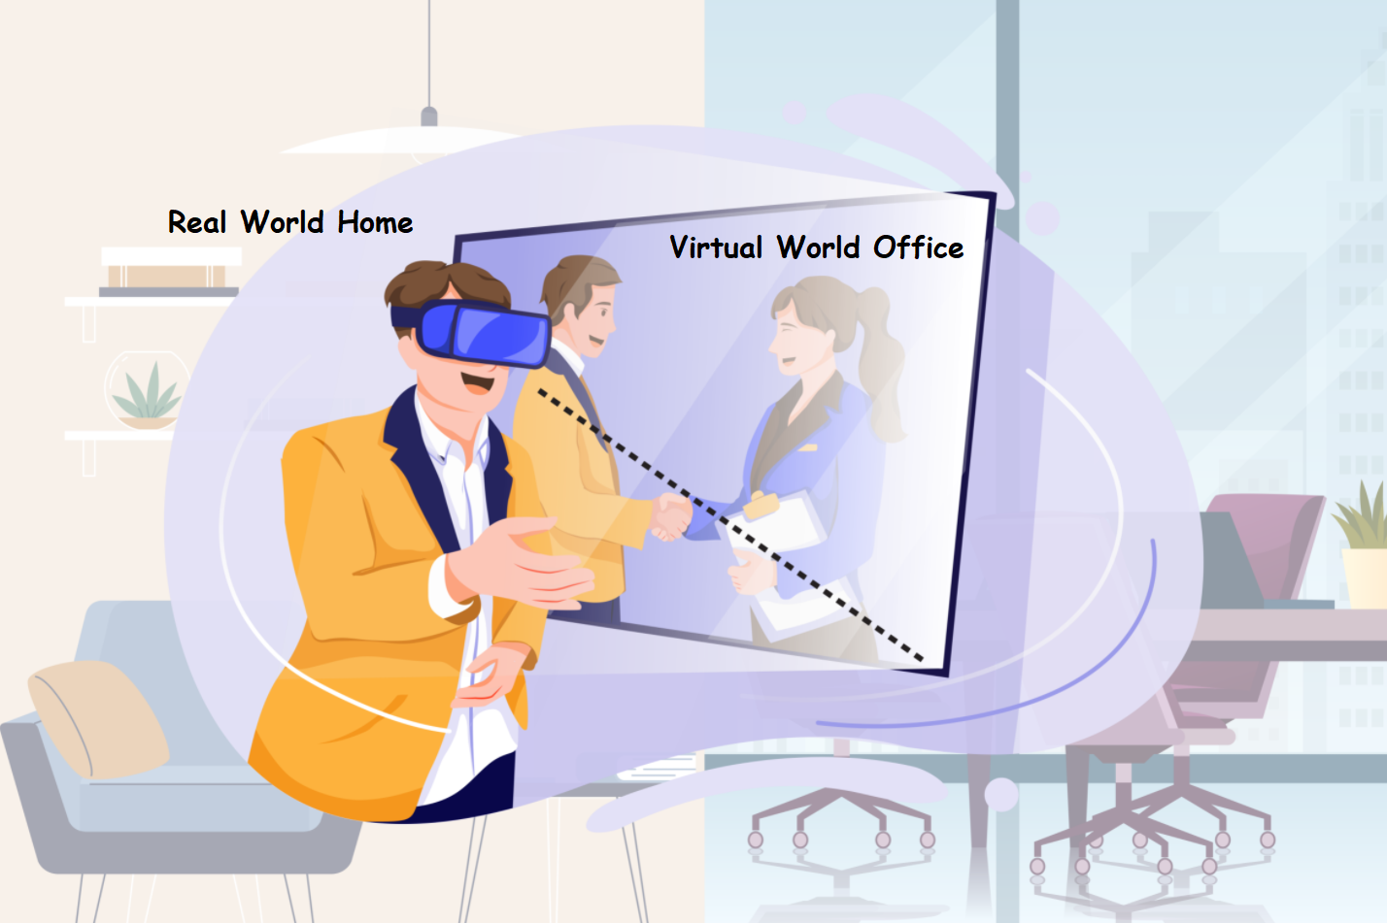
One possibility of virtual reality in future!

Slide 4
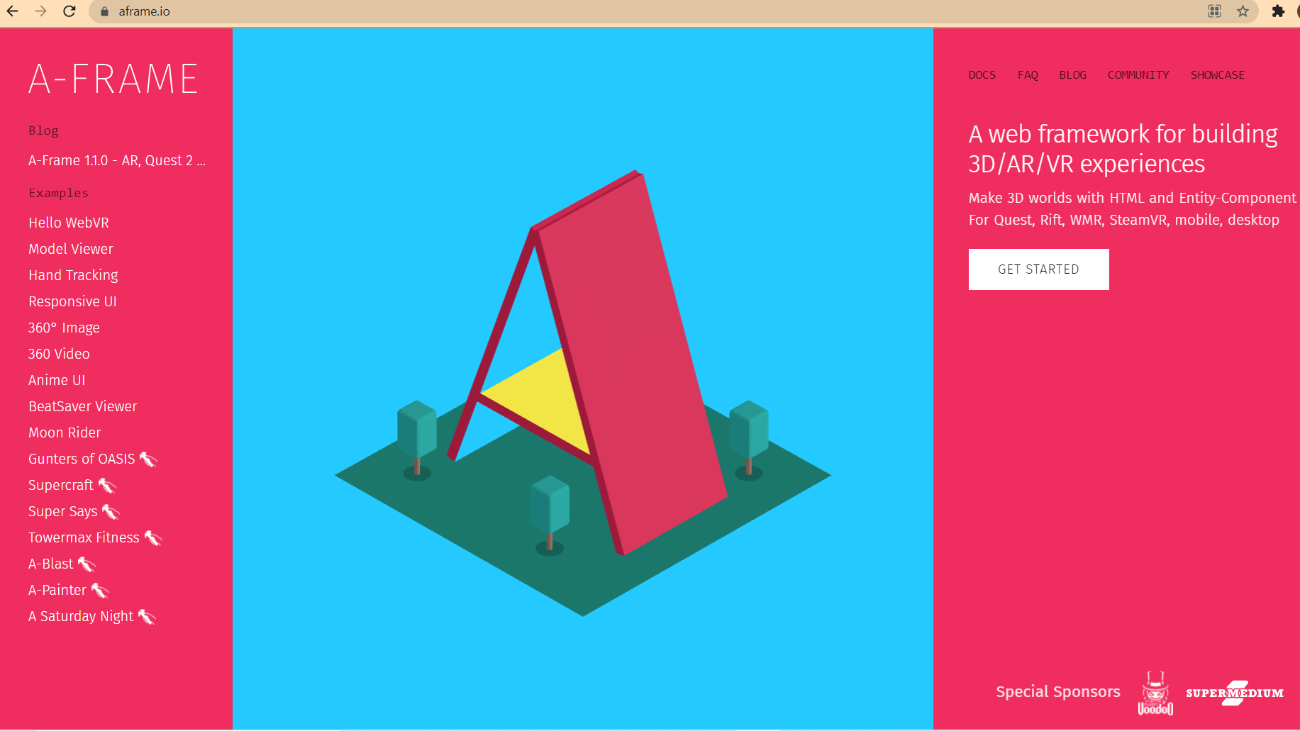
Framework
A-Frame is a framework to create Web Based Virtual Reality environments/simulations.
A-Frame HTML & JavaScript based framework.
Source: https://aframe.io/

Slide 5
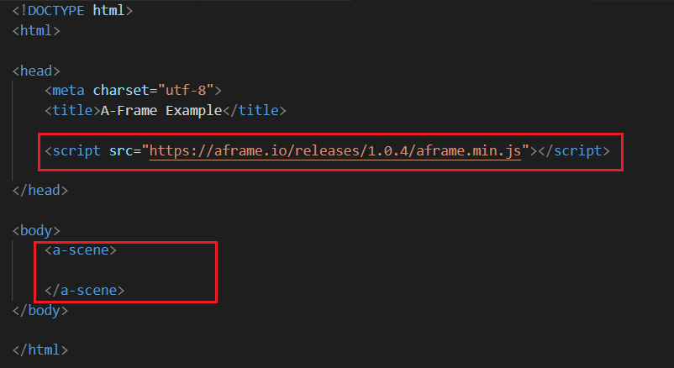
Creating Virtual Environment Scene
<a-scene>
Notes:
Discuss with the students, how the basic virtual environment scene can be created.

Slide 6
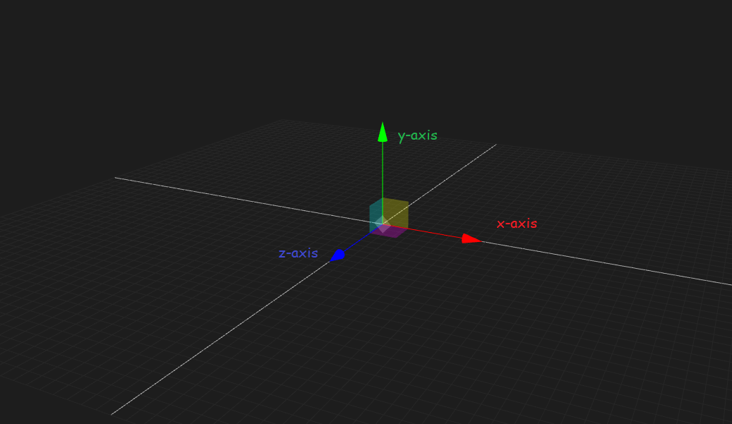
3 Dimensions
The 3 dimensions
are represented
by:
x-axis
y-axis
z-axis

Slide 7
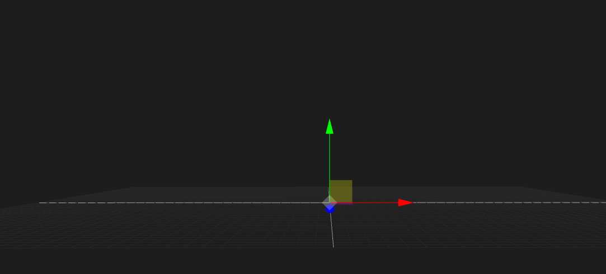
3 Dimensions
The +ve z-axis points towards us(i.e. coming out of the computer).

Slide 8
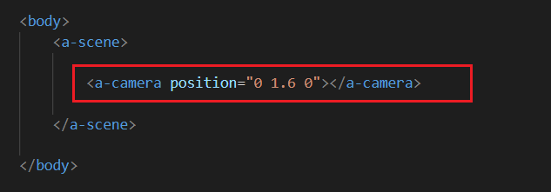
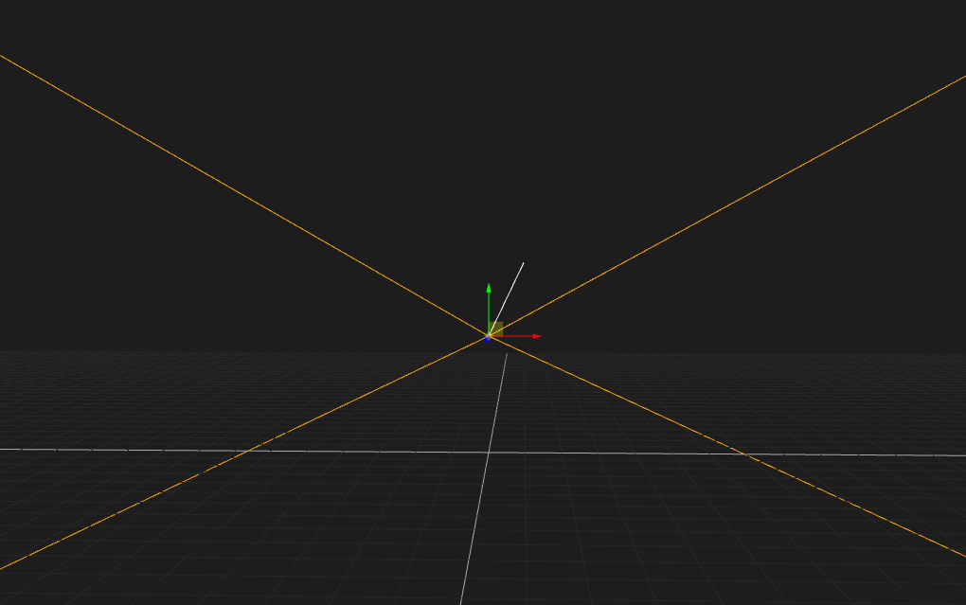
A-Frame Camera
<a-camera> primitive or camera component. Camera decides what we can see in the scene. The camera always points towards the -ve z-axis(into the computer, away from us) in the scene.

Slide 9
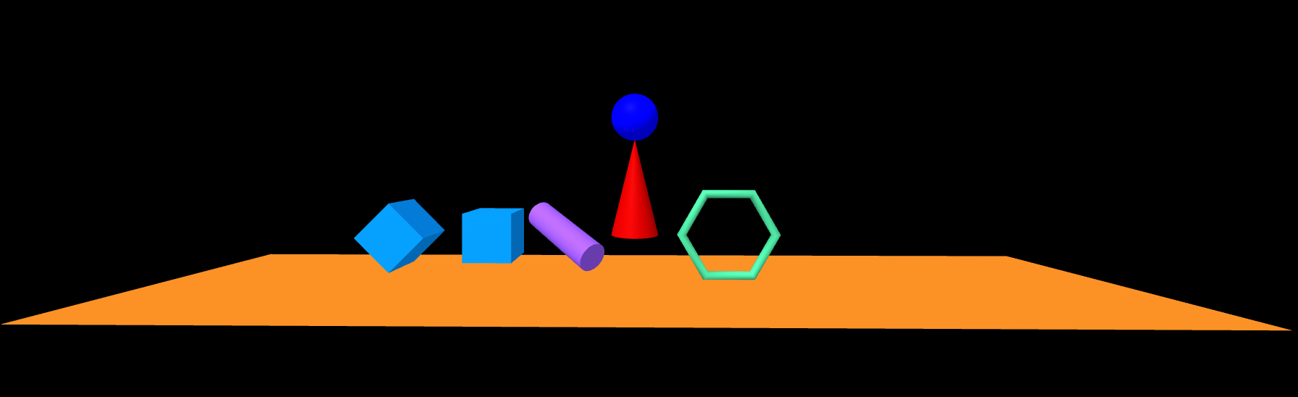
A-Frame Primitives
A few A-Frame primitives have been created to add 3D objects in the scene using just tag similar to HTML such as:
<a-box>; <a-sphere> ; <a-torus> ; <a-cylinder>; <a-cone>; <a-plane> ; so on...

Slide 10
A-Frame Entity
<a-entity>
Entities are container objects.
Entities do not have any properties to render anything on their own.
We can attach components to the entities to render objects in the scene.

Slide 11
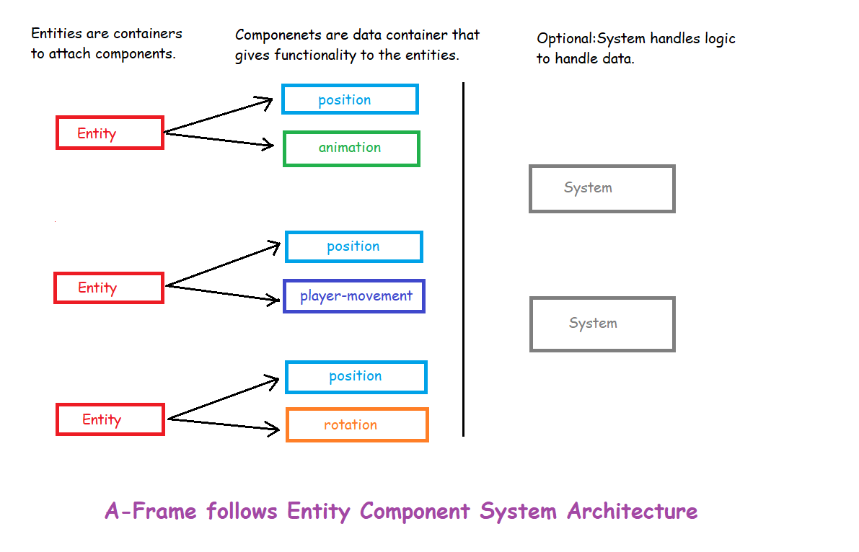
Entity Component System?
ECS is an architecture.
It is followed in
3D and game development.

Slide 12
Parent-Child Entity
<a-entity id=”parent”>
<a-entity id=”child-level-1>
<a-entity id=”child-level-2>
</a-entity>
</a-entity>
</a-entity>

Slide 13
Pre-defined Components
A few of the pre-defined components in A-Frame:
Environment
Light
Camera
Text
Rotation
Position
Scale
Wasd-controls
Animation
Sound
Notes:
Discuss the syntax of the components with the student. Help the student recollect where they have used these components throughout the module!

Slide 14
Custom Components
Registering our own components….
AFRAME.registerComponents(‘name’,{
schema:{
dataVar1: {type: “string”, default: “ ”},
dataVar2: {type: “number”, default: 0}
},
init: function() {
console.log(this.data.dataVar1)
},
update:function() {},
tick:function() {},
})

Slide 15
Asset Management System
This is used to preload(before the scene is loaded) all the assets:
<a-assets>
<a-asset-item></a-asset-item>
<img>
<video>
<audio>
</a-assets>

Slide 16
3D Models(gLTF, obj)
3D models are three-dimensional representation of any physical object. These are created using computer softwares tools by 3D artist/modellers. The art of creating 3D models is called 3D modelling.
A-Frame predefined components to add 3D models in the scene.
gltf-model component
obj-model component

Slide 17
Cursor Based VR Interactions
<a-cursor></a-cursor>
Cursor Based events:
click
mouseenter
mouseleave

Slide 18
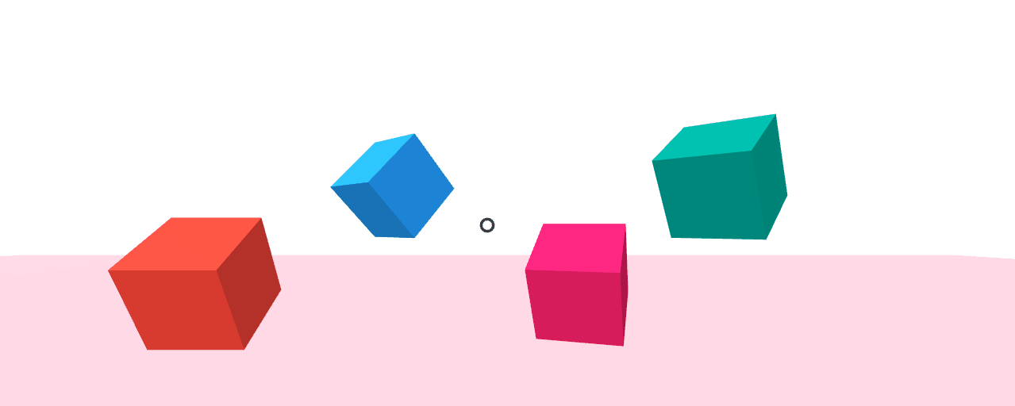
Cursor “mouseenter” event example
Change background color when the mouse cursor enters over the box.

Slide 19
Navigation Meshes
Navigation Meshes are 3D Meshes(Models) which are created to convert the virtual environment into walkable and non-walkable areas.
A-Frame aframe-inspector-plugin-recast component can help us build navigation meshes very easily.
Using this components, we can create the mesh using the tool in the A-Frame framework.

Slide 20
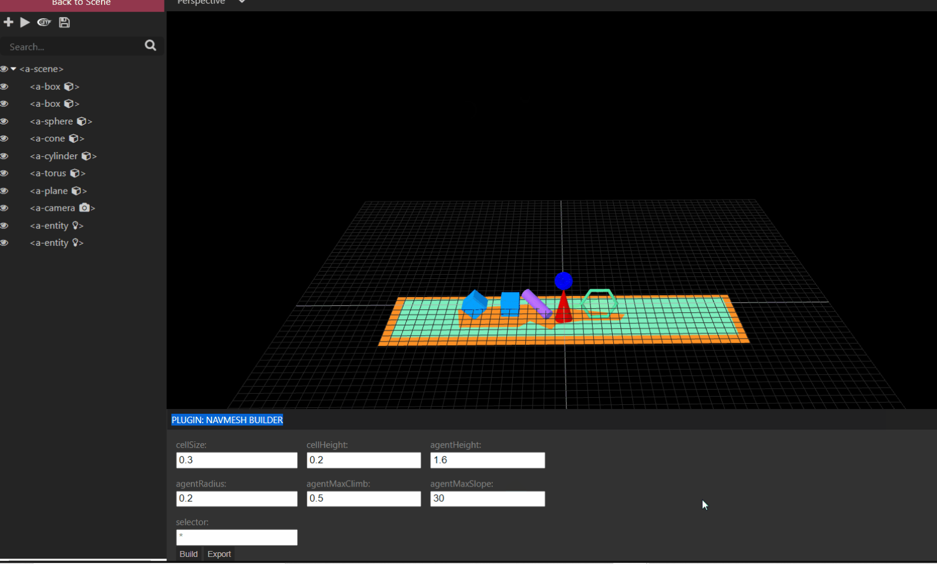
Build & Export NavMesh
https://s3-whjr-curriculum-uploads.whjr.online/2a0f34db-585d-41e0-9e19-35d85a1e8c15.gif

Slide 21
3D Physics Engine
We can use 3D Javascript physics engine libraries in A-Frame to add physics based environments in the virtual reality.
Physics engines helps us to create environments where physics laws are applicable.
A-Frame has a pre-defined component, “aframe-physics-system”, to convert entities into physics based bodies(dynamic and static bodies).
This component uses Cannon.js, a 3D Javascript physics engine library in the background.

Slide 22
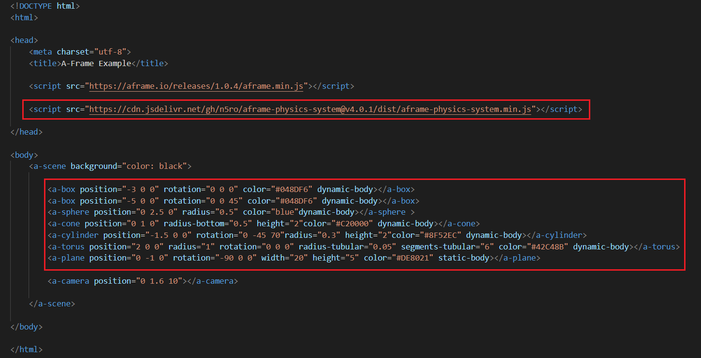
3D Physics Engine in VR

Slide 23
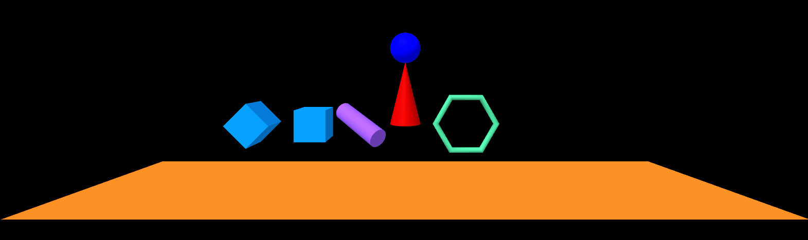
3D Physics Engine in VR

Slide 24
Building with Three.js
Three.js is a JavaScript Library to create the web based virtual reality simulations.
A-Frame is built over Three.js, that means A-Frame uses Three.js in the background.
Hence we can also use A-Frame scene/entities as Three.js library objects. This helps us to use methods from the Three.js library which not directly available in the A-Frame framework.

Slide 25
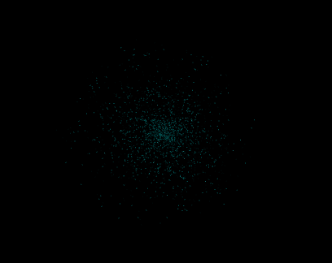
Celebrating the virtual future!
Yay!!!!

